Slide 1
Responsive Design
via Bootstrap
Presented by Steven King

Slide 2


Slide 3
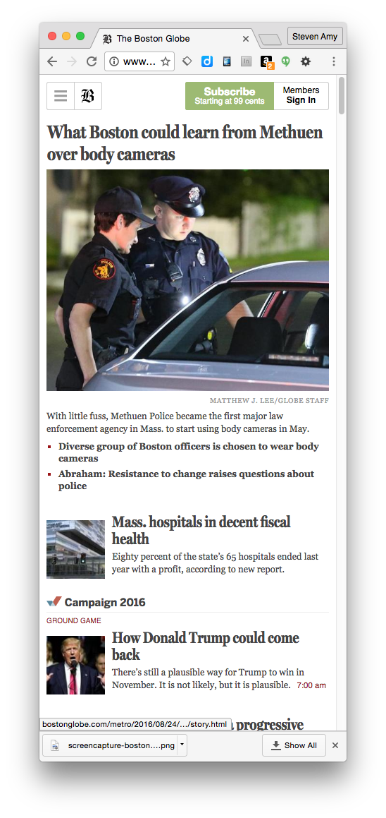
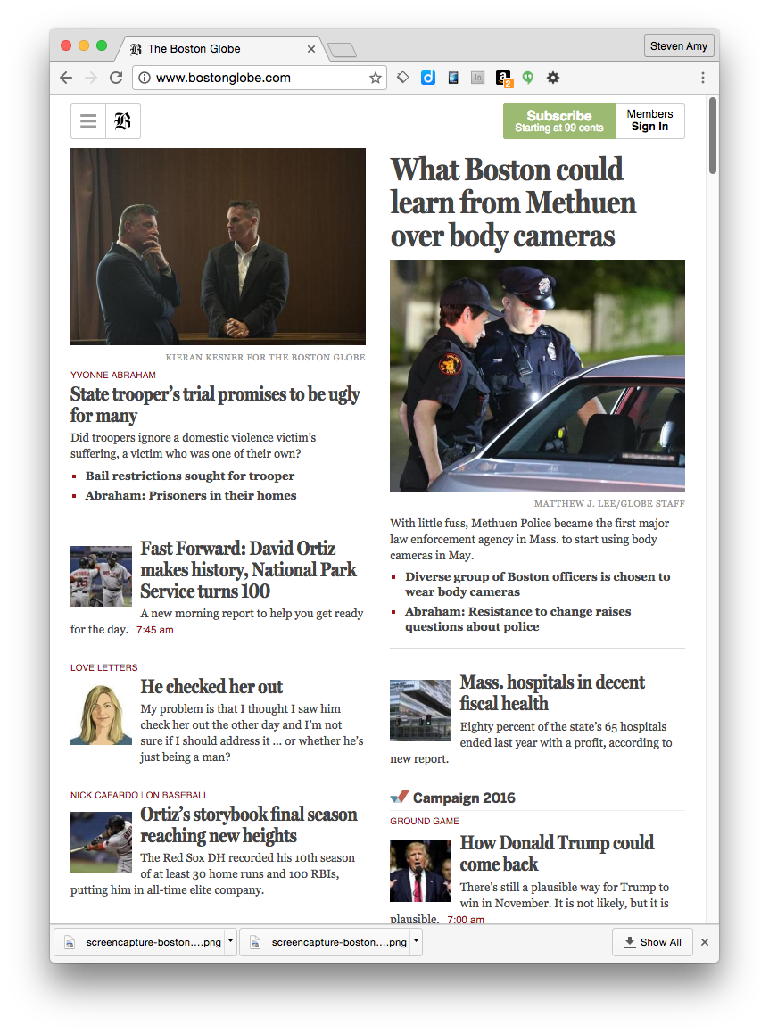

Slide 4


Slide 5
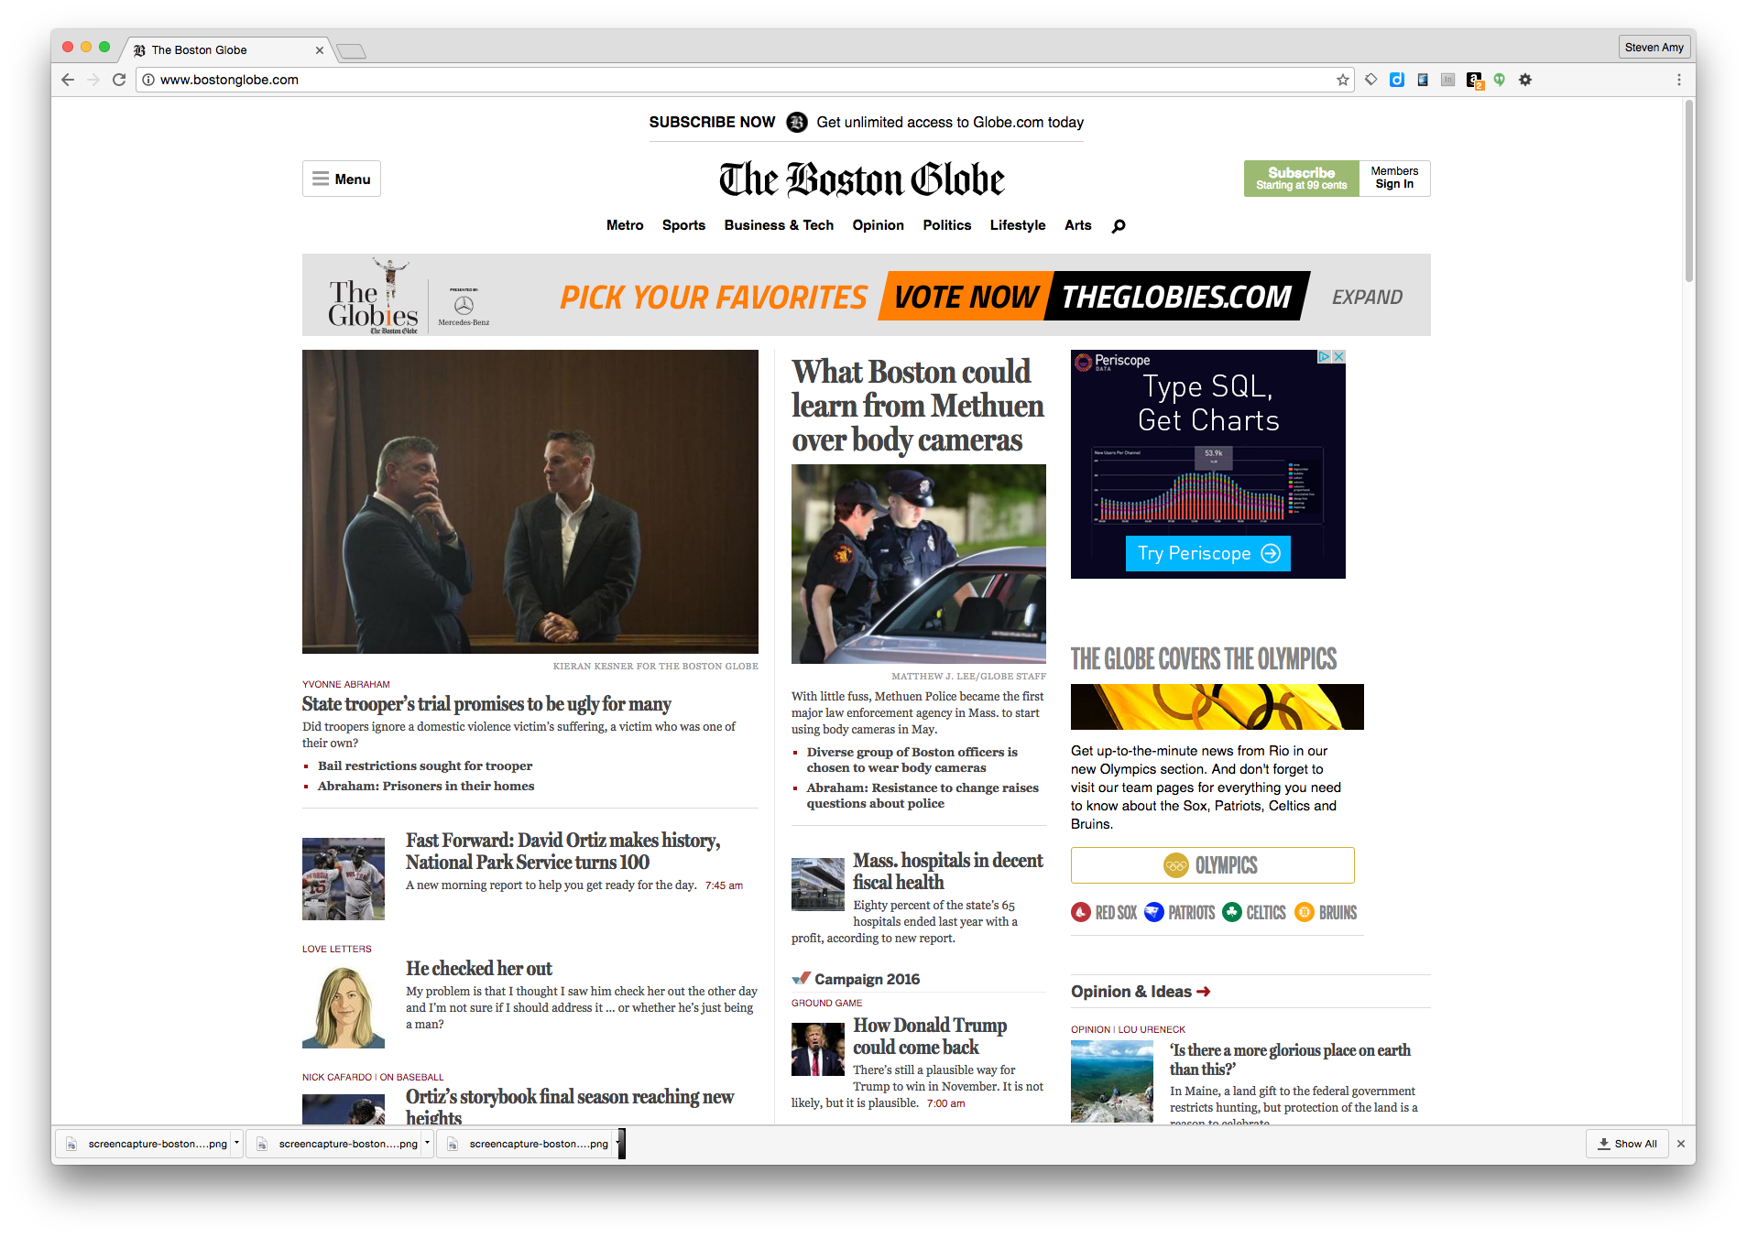

Slide 6


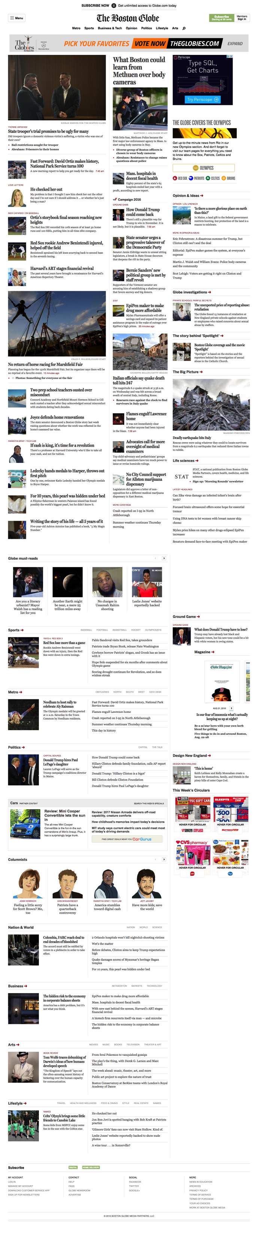

Slide 7
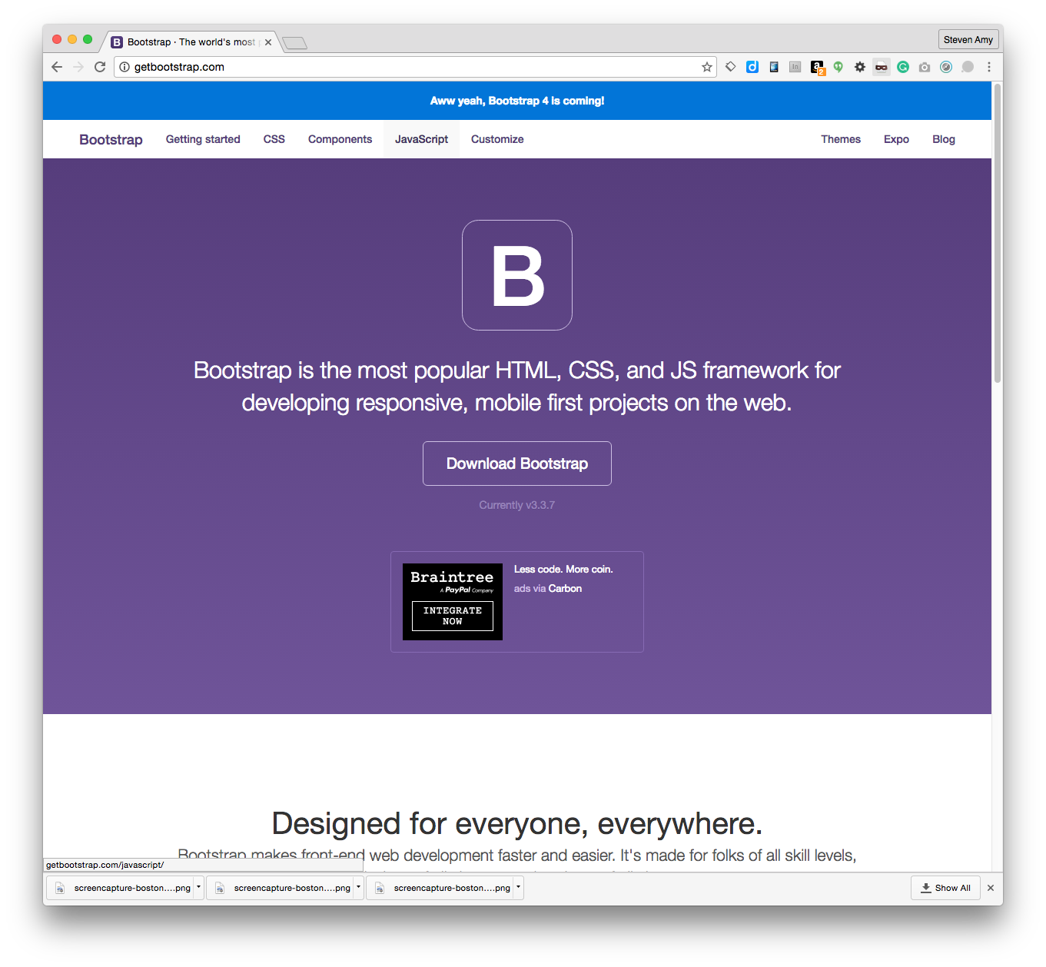
Get Bootstrap
getbootstrap.com

Slide 8
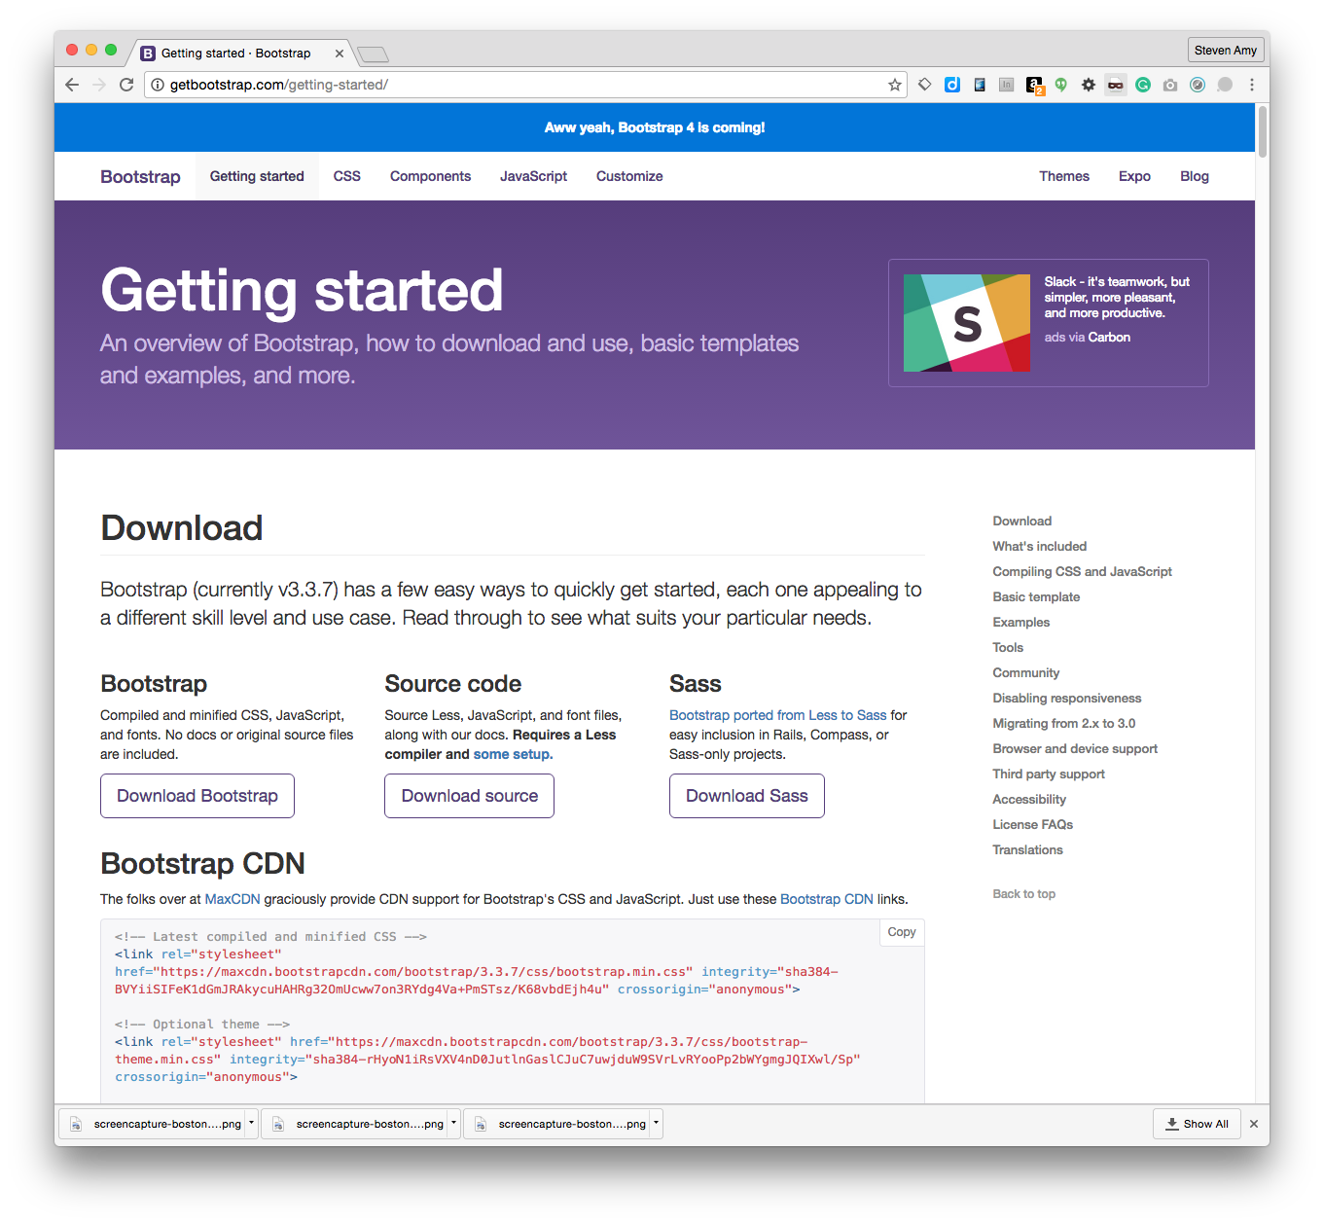
DownloadBootstrap
getbootstrap.com/getting-started

Slide 9
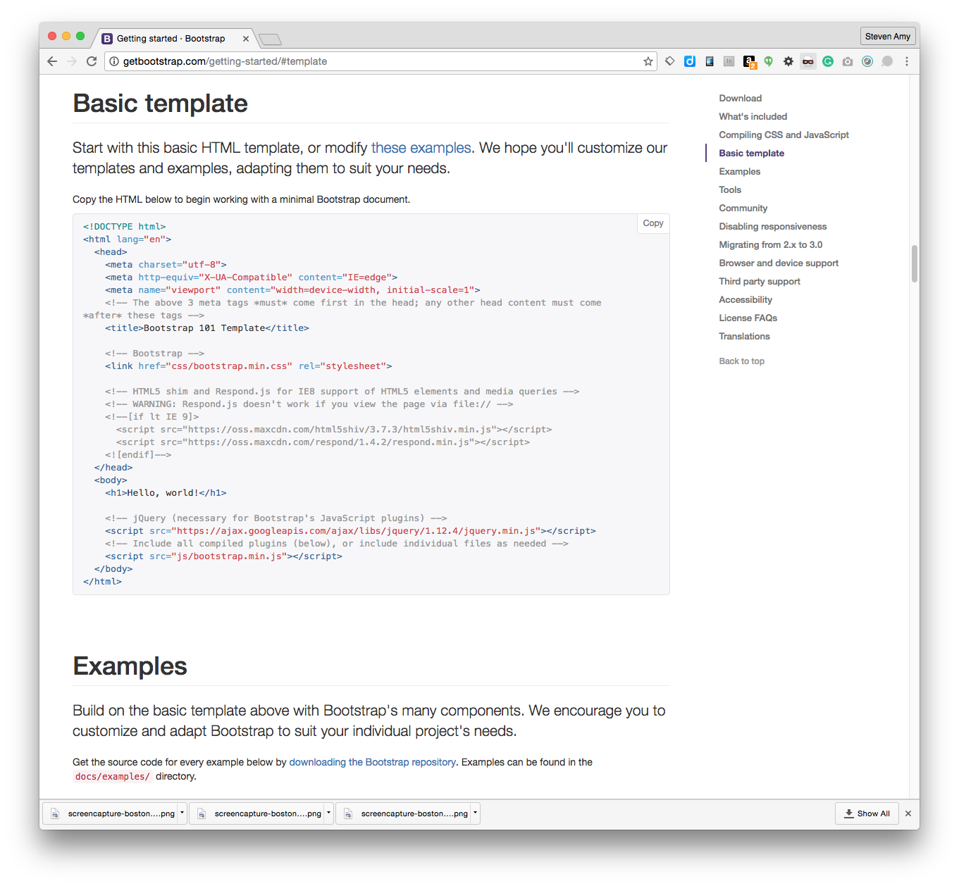
Setup Template
getbootstrap.com/getting-started/#template

Slide 10
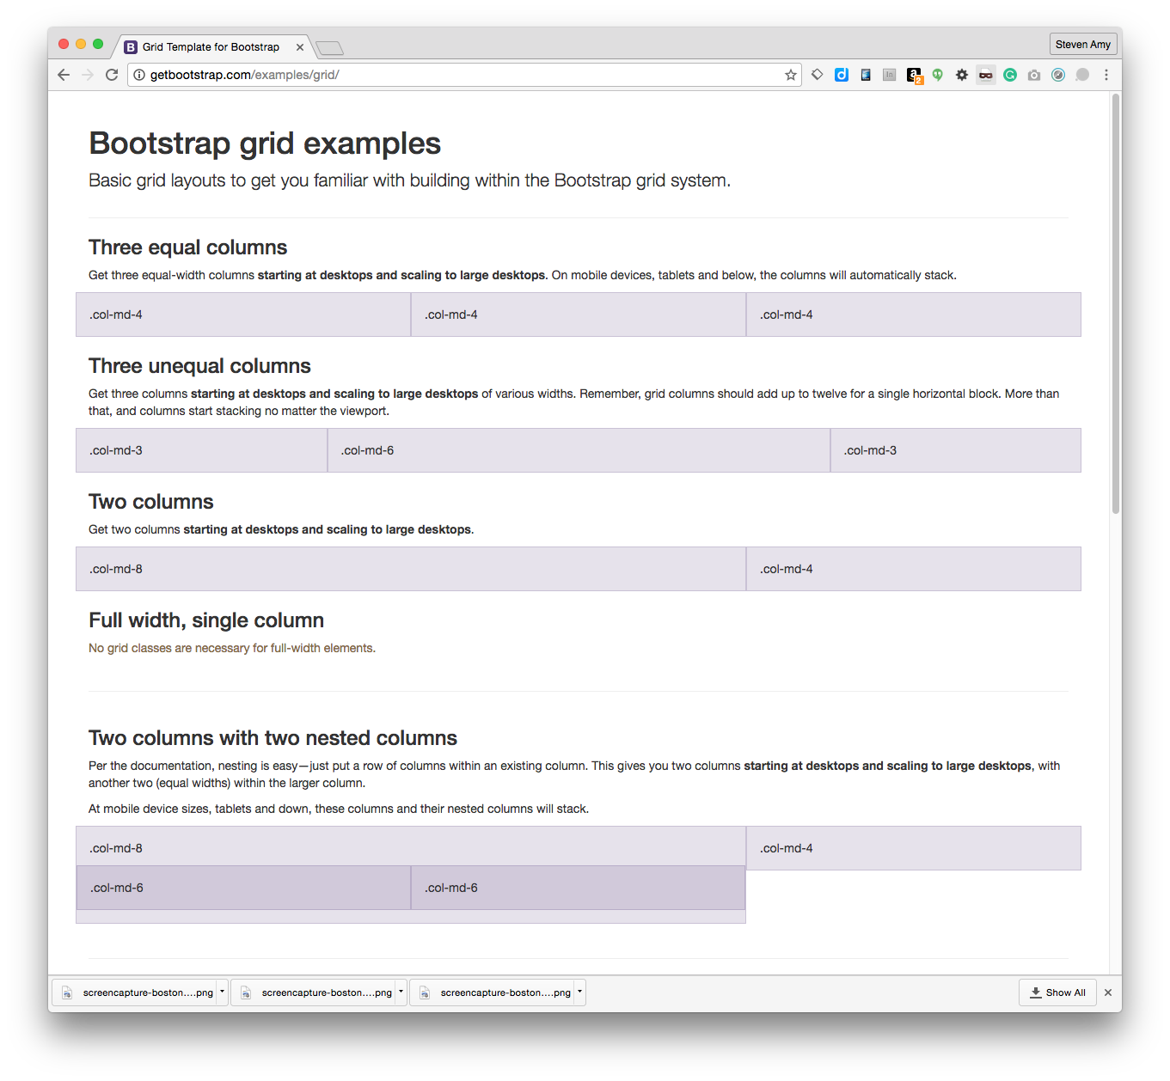
Understand
The Grid
getbootstrap.com/examples/grid

Slide 11
Understand
The Grid
How it works:
There is a container.
The container has rows.
There are up to 12 columns in a row.
getbootstrap.com/examples/grid
col-md-8
Col-md-4

Slide 12
Understand
The Grid
How it works:
There are break points for each screen size
XS, Small, Med, Large, XL,
getbootstrap.com/examples/grid
Small
Med
col-md-8
Col-md-4
col-md-8
Col-md-4

Slide 13
Understand
The Grid
How it works:
There are break points for each screen size
XS, Small, Med, Large, XL,
getbootstrap.com/examples/grid
Small
Med
col-md-8
Col-md-4
col-md-8
Col-md-4

Slide 14
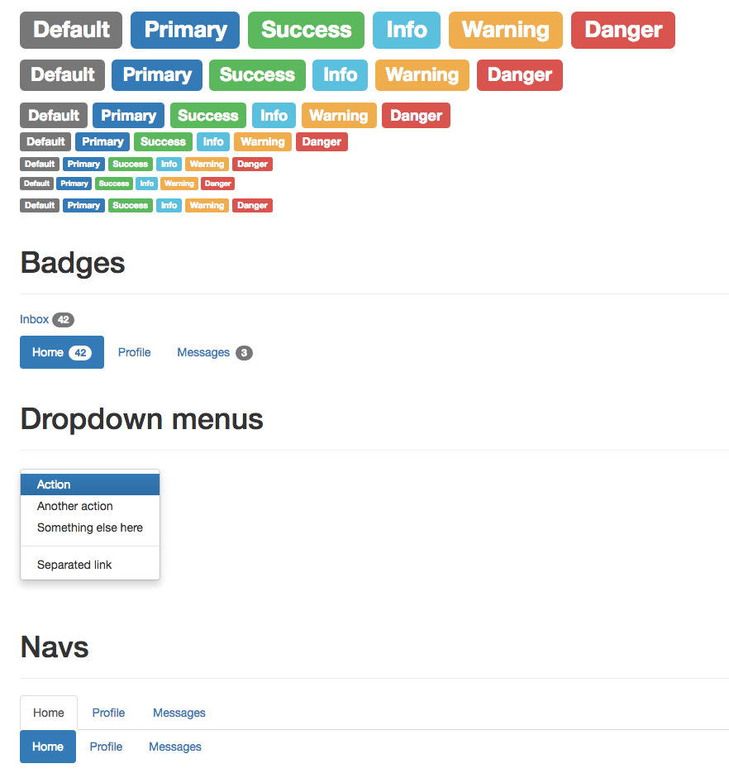
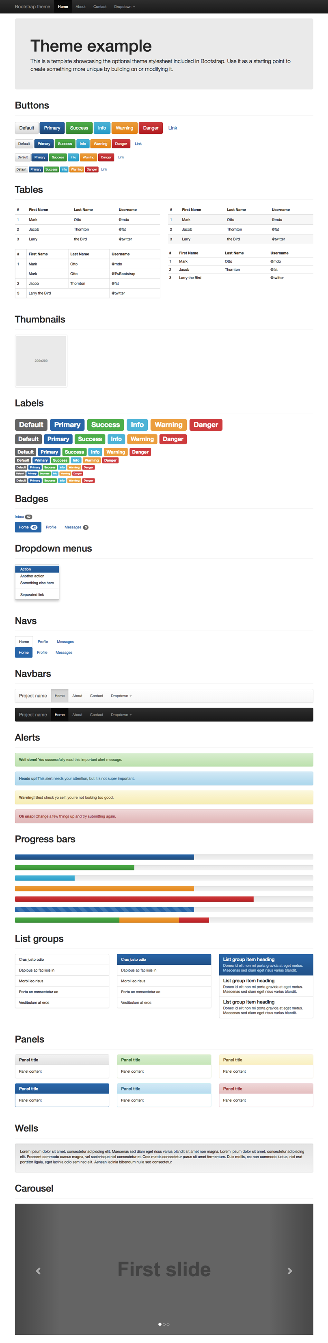
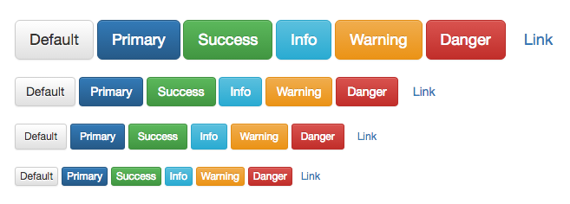
The Extras
getbootstrap.com/examples/theme/

Slide 15

Let’s
Try it!
For Real

Slide 16
Build a single page travel site about a specific location using the standard Bootstrap template.
Use Creative Commons Images and Wikipedia text with credits
Nav bar should link to other students projects (requires talking, planning, coordination)
Upload to your own server and link to friends.
Post link as an issue in Github.
Assignment
Putting into practice

